Slide 1
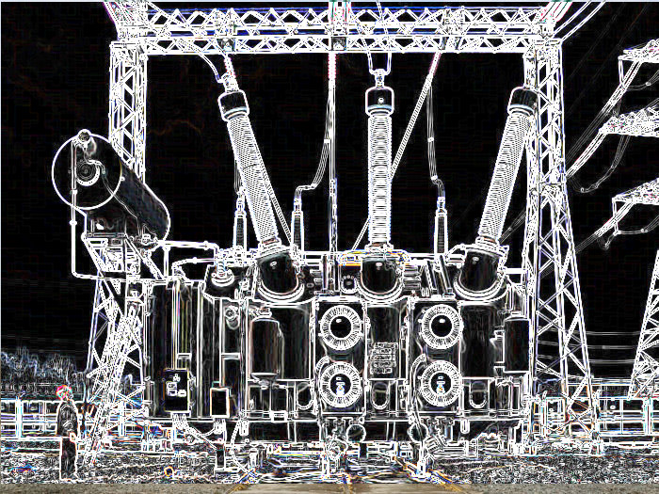


New generation of engineers –foundation for a secure future of electric power industry

Slide 2
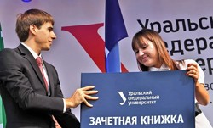
Goals of the program
Public authorities
Training the new generation of Russian energy professionals
Development of incentives for potential employers to invest in human capital, and a succession pool made of graduates of Russian technical universities
Making for development of talent, professional excellence, and potential for creativity and innovation in the young people of today
Energy sector organizations:
SО, grid companies, energy companies, research facilities
Technical universities
Funds and non-government organisations

Slide 3
Principles of the RNC CIGRE Youth Section Program
All-Russian coverage
Operating openly and publicly
Common meeting site for public authorities, power industry organizations, and technical universities
International status
Special implementation mechanism – via energy departments of Russian technical universities
Traditions and their continuation
Planning and regularity
Cooperation agreements with the leading Russian technical universities
Declared objectives, principles and forms of activity
Organization management hierarchy
Informational independence
Regulations and Standards

Slide 4



Managers and professors of principal departments of technical universities
Organisation
Experts, scientists, specialists
Organising Committee
RNC CIGRE university coordinators
Young specialists: post-graduate students, external PhD candidates, young scientists and engineers
Students:
Bachelor, Specialist and Master degree courses
Documentation
Program Regulation for the RNC CIGRE Youth Section
Regulation on CIGRE Membership for Participants of RNC CIGRE Youth Section Events
Regulation on the Organising Committee of the RNC CIGRE Youth Section
Action Plan of the RNC CIGRE Youth Section Program
              Contract Relationship
Youth Section Program
Universities,
cooperation
agreements

Slide 5


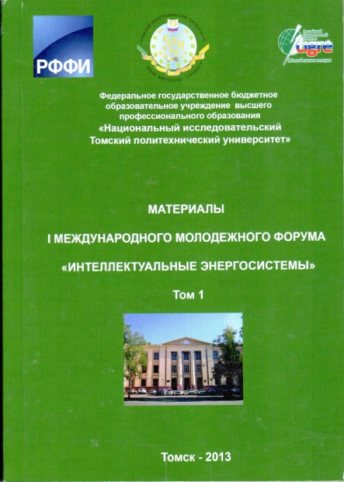

Information Activities
Web-page of the RNC CIGRE Youth Section: РНК СИГРЭ at: http://cigre.ru/rnk/youth/
Publications: reports on activities within
the RNC CIGRE Youth Section Program
for 2012 and 2013
Publications: issues 1,2,3,4 and 5 of RNC CIGRE Bulletin covering activities within the RNC CIGRE Youth Section Program
8 videos on activities within the RNC CIGRE Youth Section Program
75 press-releases on activities within the RNC CIGRE Youth Section Program
8 regulations on activities within the RNC CIGRE Youth Section Program

Slide 6
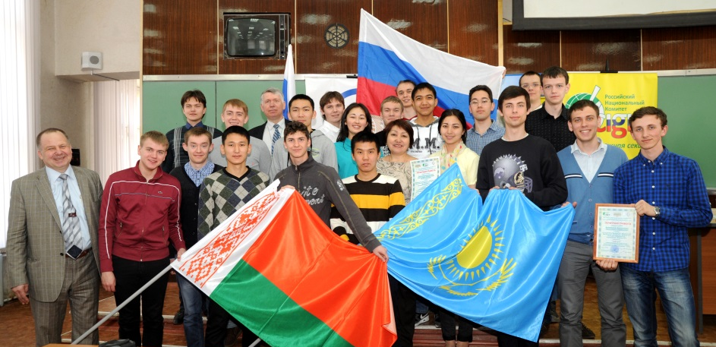
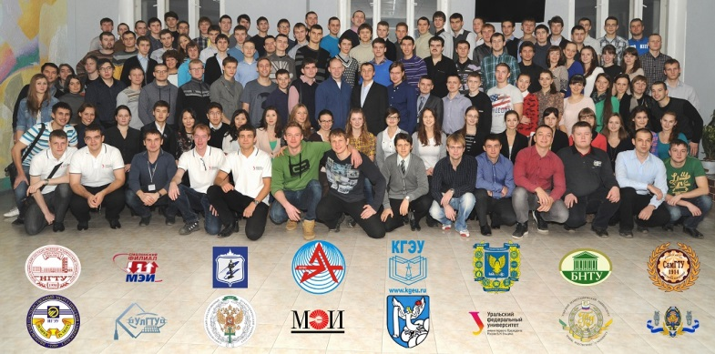
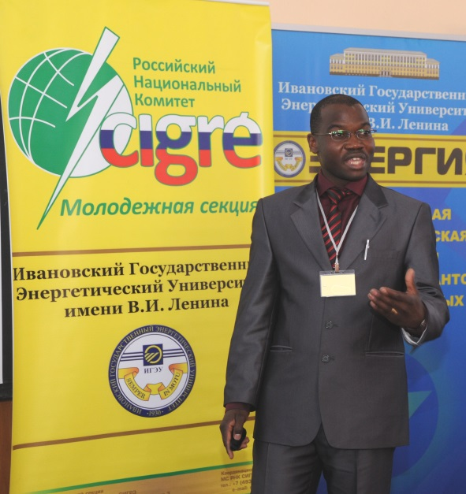
Events
              Twenty three (23) events took place in 2012-2014 including 3 international events. The total of over 3,500 Russian and foreign students and young engineers from grid and generating companies has taken part in the events:
              Quizzes
              Academic competitions
              Conferences
              Forums
              Case competitions
              Training workshops

Slide 7
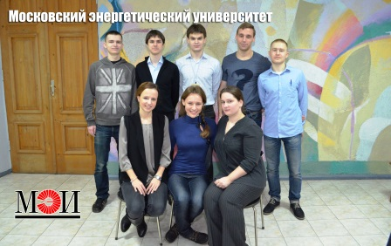
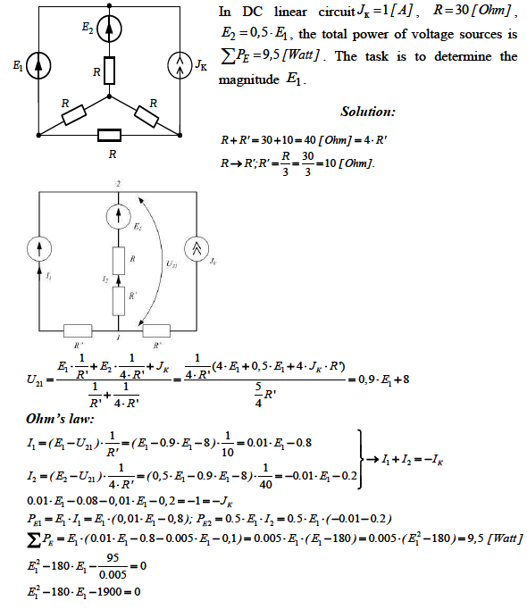
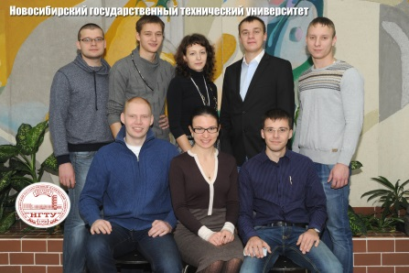
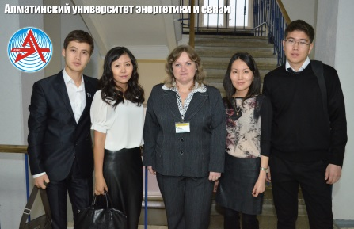
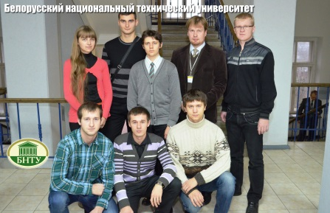
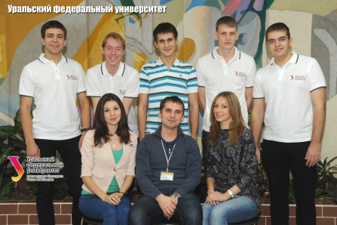
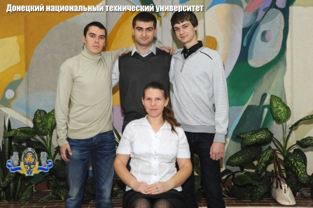
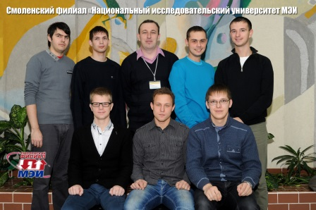
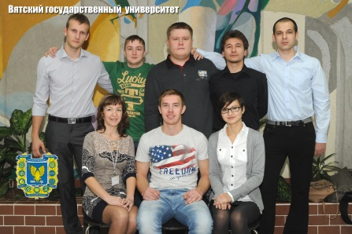
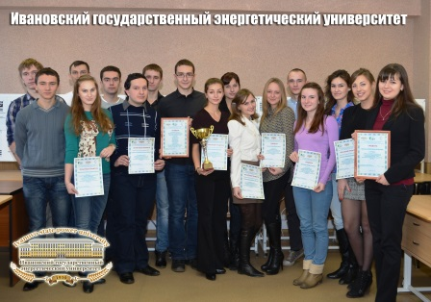
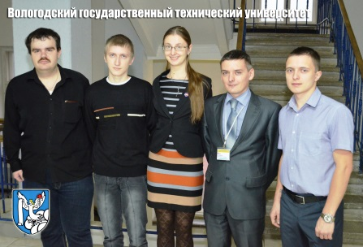
International Students Electric Power Engineering Competition
International Students Electric Power Engineering Competition is an annual event welcoming 131 students from 19 technical universities of Russia, Kazakhstan, Belarus and Ukraine. The competition of 2013 took place in November 15-17
Winners:
Team of the Ivanovo State Power Engineering University
Teams of the South Ural State University and the Ulyanovsk State Technical University
Teams of Novosibirsk State Technical University, the Belarusian National Technical University, and the National Research University “Moscow Power Engineering Institute” (MPEI)

Slide 8

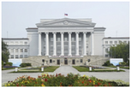
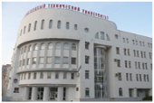


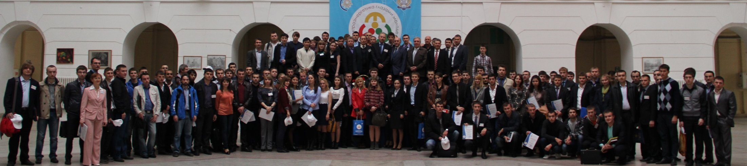
International Scientific and Technical Conference:
“Electrical Power Engineering: viewpoint of the Young”
              November 17-19, 2010 – UrFU, Yekaterinburg
I
              November 21-25, 2011 – SamSTU, Samara
II
              October 22-26, 2012 – UrFU, Yekaterinburg
III
              October 14-18, 2013 – SRSPU, Novocherkassk
IV
              November 10-14, 2014 – NR TPU,
              Welcome to Tomsk, Russia
Being the oldest engineering higher school in the Asian part of Russia, Tomsk Polytechnic University has produced generations of graduates who have gone on to become leaders in all areas of society and industry
              http://www.eegm2014.enin.tpu.ru/en, organisational fee - non!
V

Slide 9





















We express our thanks to the partners of the RNC CIGRE Youth Section Program
Andrey Gofman
gofman-av@so-ups.ru

